Slide 1
Journey Map
Megha Sharma
Associate Data Engineer
Emp ID: 654810

Slide 2
Soft Skills

Slide 3
Key Learnings – Soft Skills (14/08/23)
Professionalism and Etiquette
Time Management
Self awareness
Adhering to a dress code
Behaviour in the office
Difference between a college setting and a corporate setting
How to organize and manage time effectively
Prioritize tasks, set goals, and manage our time efficiently
Self-awareness in the workplace empowers you to make conscious choices, communicate effectively, collaborate harmoniously, and continually evolve as a professional.
Having a clear understanding of your own strengths, weaknesses, emotions, values, and behavioral tendencies

Slide 4
Key Learnings – Soft Skills (16/08/23)
Communication Etiquettes (Video, Audio, Chat )
Adhering to respectful and effective guidelines when interacting with others
Listening
Team and Teamwork
Types of listening
Good listening vs Bad Listening
Teamwork is crucial for leveraging diverse skills, pooling resources, and fostering collaboration to achieve collective goals efficiently and creatively in any organization or project.
Encompassing aspects like active listening, clarity, courtesy, and appropriate tone to facilitate smooth and productive conversations.

Slide 5
Key Learnings – Soft Skills (17/08/23)
Email Etiquettes
Communication Skills
Body Language
Listen, Understand and Empathise
Presentation Skills
Fluent speaking
How to address the audience
Mannerisms
Not using filler words
Clear and concise language, proper formatting, addressing recipients correctly, and being mindful of tone and timing to ensure professional and effective communication in written correspondence.
Body Language

Slide 6
Foundational Skills

Slide 7
Business Analysis & Agile (18/08/23)
Professionalism and Etiquette
Time Management
Self awareness
Adhering to a dress code
Behaviour in the office
Difference between a college setting and a corporate setting
How to organize and manage time effectively
Prioritize tasks, set goals, and manage our time efficiently
Self-awareness in the workplace empowers you to make conscious choices, communicate effectively, collaborate harmoniously, and continually evolve as a professional.
Having a clear understanding of your own strengths, weaknesses, emotions, values, and behavioral tendencies

Slide 8
Business Analysis and Agile (Scrum) (21/08/23)
Understanding Agile DevOps on Azure in depth
Backlogs, Boards
Test plan, User stories, Epics, Issues etc.
Sprint (+ Iteration) creation
Mock daily stand-up meeting
Held mock Scrum call as a team exercise for mock application.
Visualize on Kanban Board

Slide 9
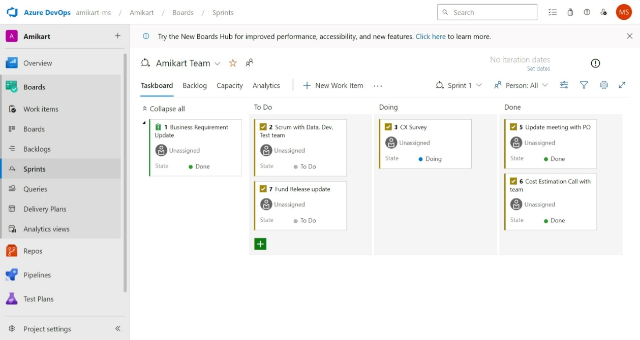
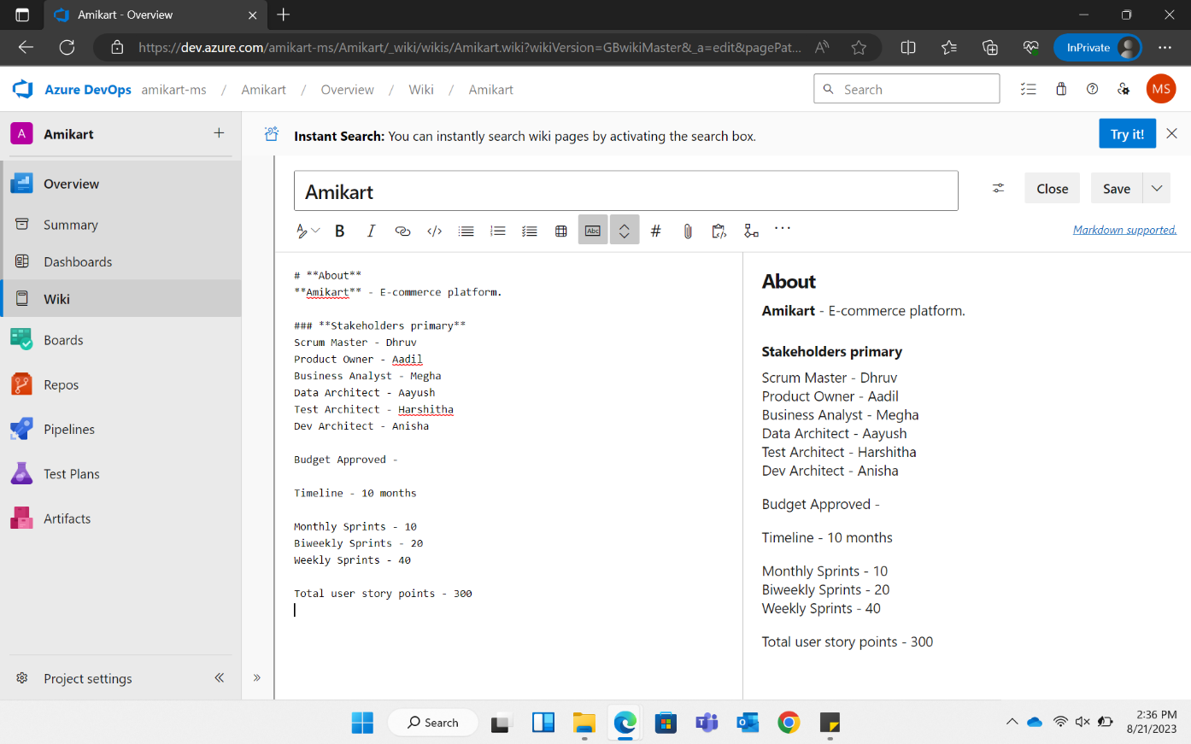
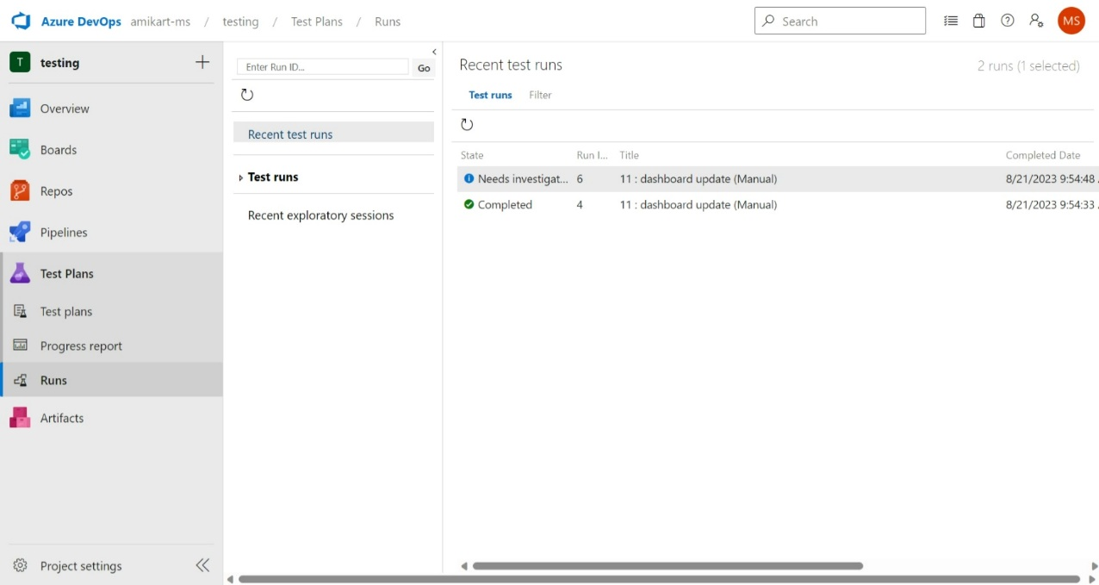
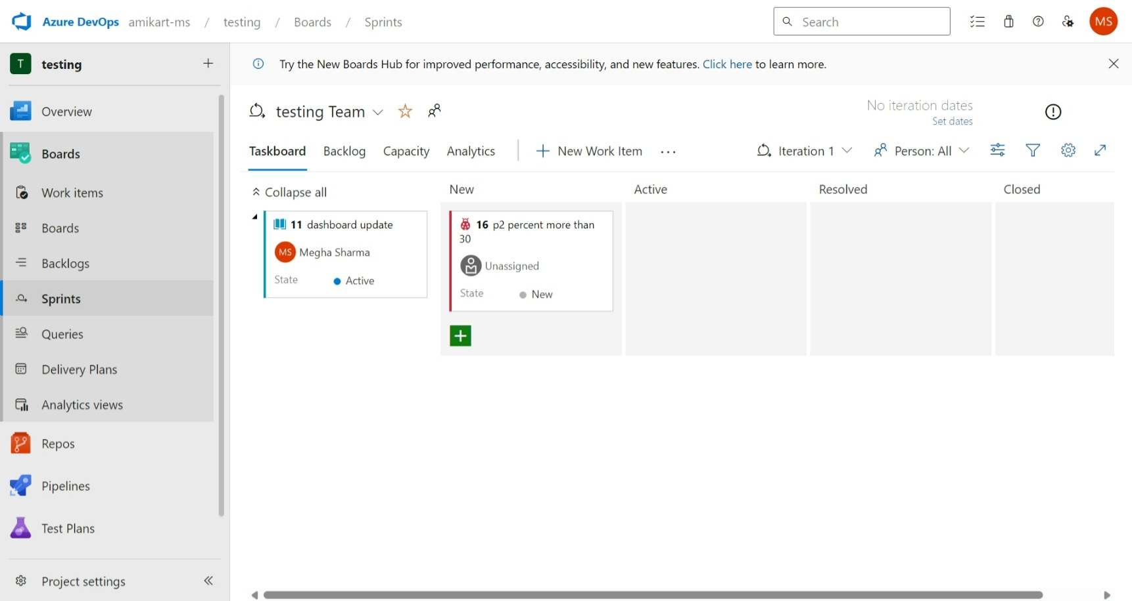

Slide 10
Database Management System (22/08/23)
SQL
DML, DDL, DQL, DCL, TCL
SELECT, WHERE, ORDER BY, GROUP BY, HAVING
Hands-on session of different SQL Queries
Normalization
1NF, 2NF, 3NF, BC-NF, 4NF, 5NF in Relational Database Management System
Joins and their types
Inner Join
Left Join (Left Outer Join)
Right Join (Right Outer Join)
Full Outer Join
Cross Join (Cartesian Join)
Self Join
Subqueries and their types
Single-row Subquery
Multi-row Subquery
Correlated Subquery
Exists Subquery
Not Exists Subquery

Slide 11
Software Development Life Cycle (SDLC)
Types of SDLC – Waterfall model, Agile model
Software failure and scope to trackback with respect to different development models
Software Testing Life Cycle (STLC)
Phases of STLC – Test Strategy, Plan, Design, Environment, Execution, Reporting, Closure
SDLC vs STLC
SDLC defines all the standard phases involved during the software development process, whereas STLC defines various activities to improve the quality of the product.
Software Testing
(23/08/23)

Slide 12
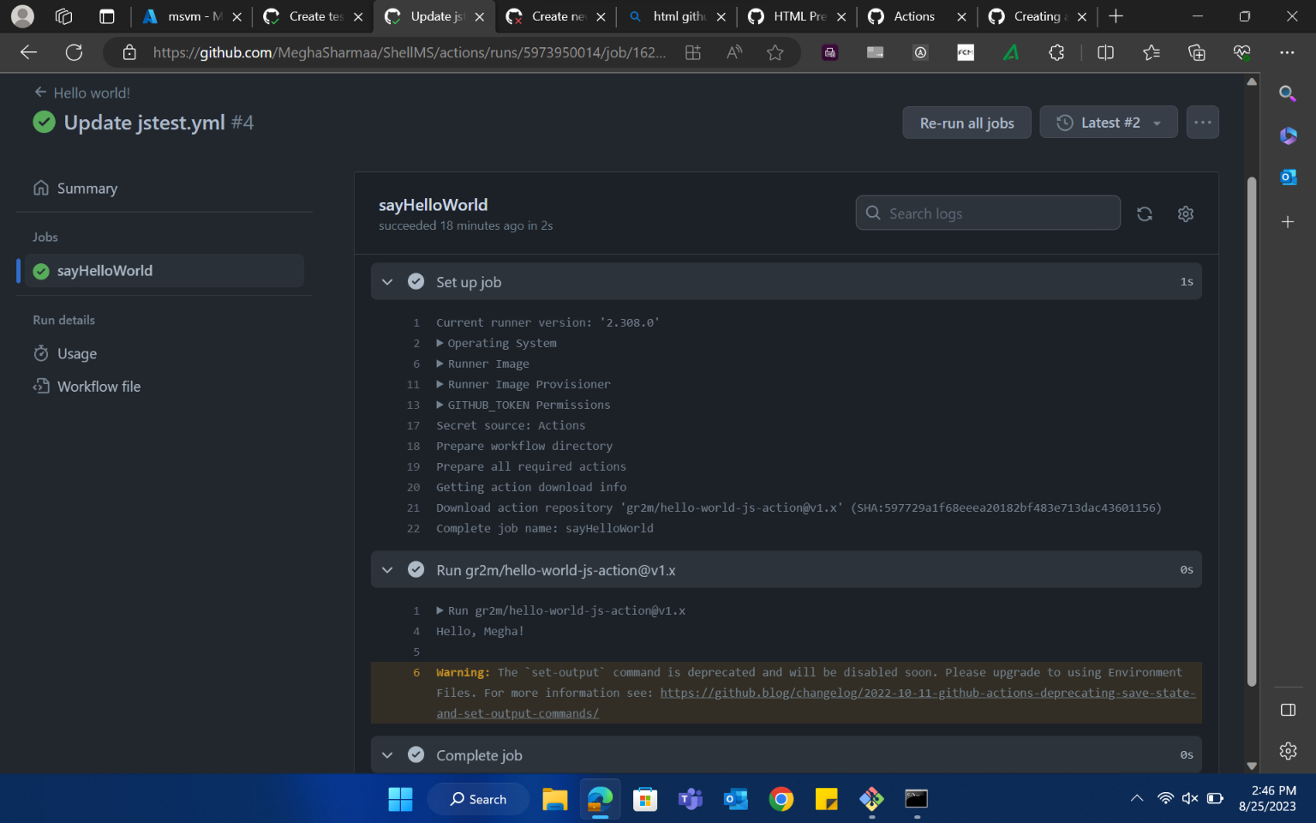


DevOps (24/08/23)
Continuous Integration and Continuous Deployment
GitHub Actions
Repository based DevOps process to make continuous changes for automation and testing
Discussed CI vs CD
Components of GitHub Actions – Workflows, Events, Jobs, Actions, Runners
Sample Action file in YAML file format

Slide 13
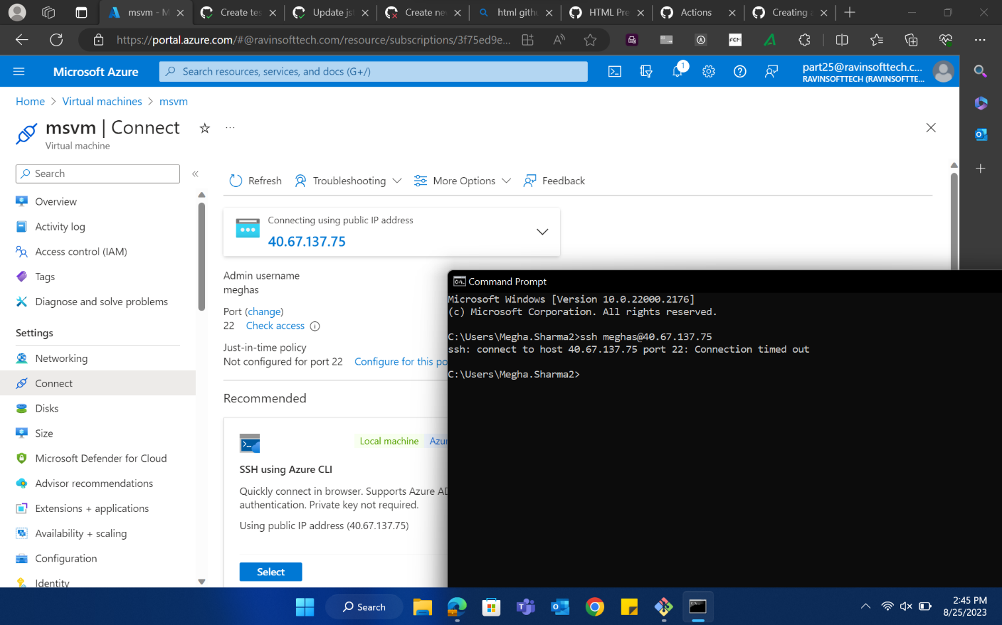
Cloud Computing (25/08/23)
Cloud Computing
What is cloud computing, it’s advantages and limitations
Concepts such as SAAS, PAAS, IAAS with examples
Using Azure’s suite of Cloud Computing tools
Virtual Machines
Creating VMs on Azure and accessing them remotely
Behaviour in the office

Slide 14
THANK YOU

